Slide 1
CaSha BiSha
Presented By: Mahesh Rathod

Slide 2
Problem Statement:
The purpose of this application to share own car and bike. This is an E‐commerce application that enables traveler to request and confirm whether to go with vehicle owner and vice-versa for vehicle owner as well.
We are living in metro city, we know traffic is there in city and around city, so this application is avoiding a bit traffic.
The natural resources are limited, this application also saves some amount of natural resources, for future use.

Slide 3
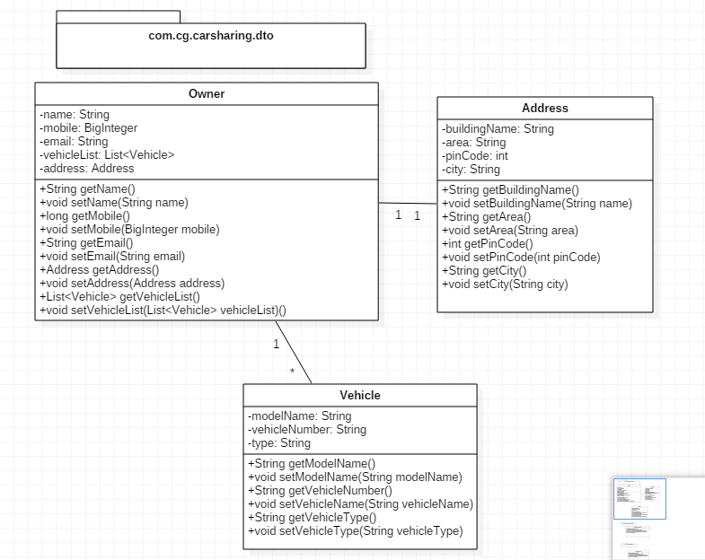
Pojo Classes with relationship

Slide 4
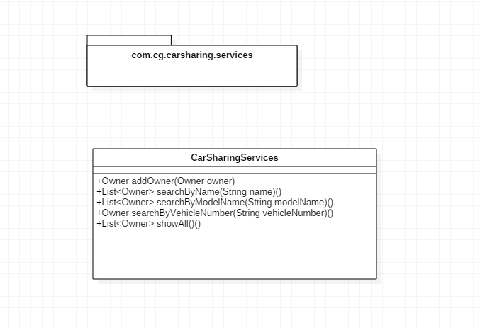
Services References

Slide 5
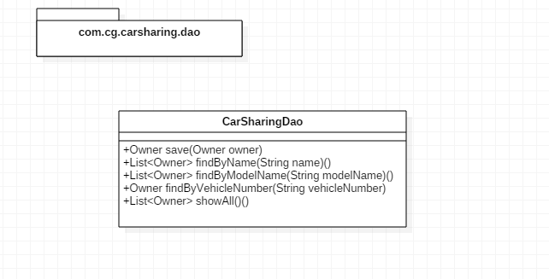
Repository

Slide 6
Thank You!
Any Question?

